Slide 1

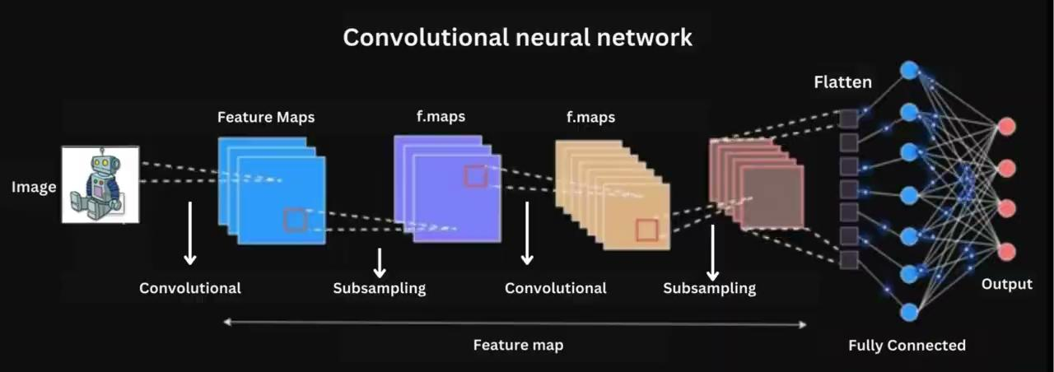
Convolutional Neural Network (CNN) Architecture
CNNs are a type of Neural Networks
inspired by how our brain processes
visual information.
They're specialized for understanding
images, making them powerful tools in
image analysis, recognition, and more.

Slide 2
Images in Computers
Understanding image channels (RGB)

Slide 3
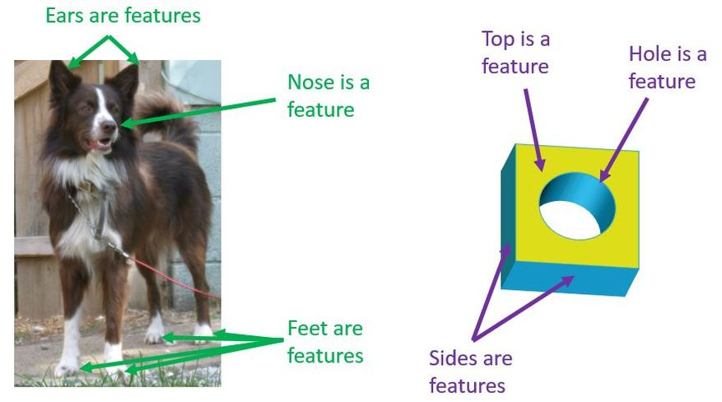
Features for Images
Images are full of important parts called features.
Features can be edges, textures, shapes, or even faces.

Slide 4
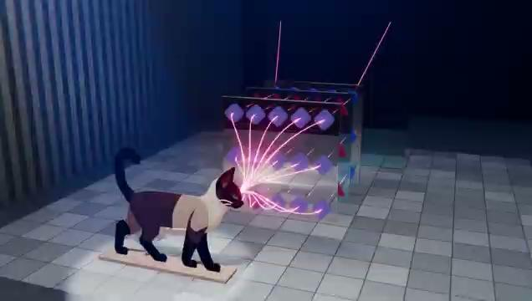
How CNN Work on Image

Slide 5
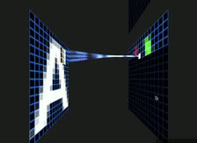
Convolution
Convolution is like a special way of looking at data. It's a mathematical operation that brings out patterns.

Slide 6
Convolution
Applies filters to the input image to
create feature maps.
Filters are small matrices that slide
over the input image and detect patterns.

Slide 7
Stride
Stride in CNN determines the step size of the filter as it moves across the input data during the convolution operation, affecting output size and computational efficiency.

Slide 8
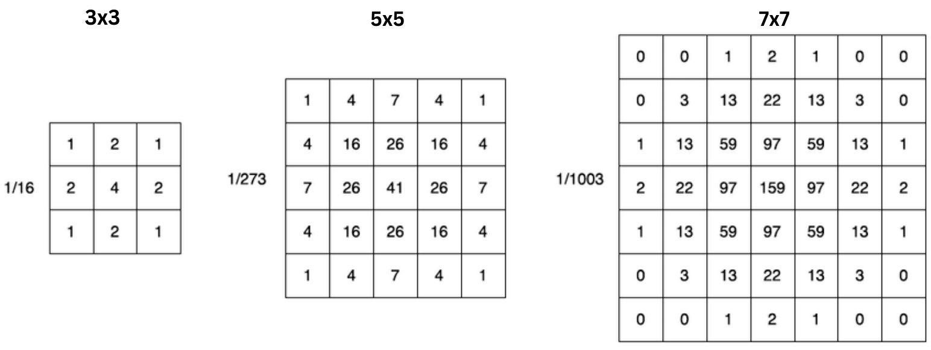
Kernel/Filter
Kernels in CNNs are usually small 2D matrices used for feature extraction through convolution operations on input data, typically with dimensions in odd numbers.

Slide 9
Convolution Operation
At each position, the kernel performs el﻿ement-wise multiplication with the corresponding part of the input data it covers.
Then, the results of these multiplications are summed up to produce a single output pixel.

Slide 10
How Kernels Work
Convolution on an (h, w, in_dims) image gives an (h', w', out_dims) feature map.

Slide 11
Vertical Edge Detection

Slide 12
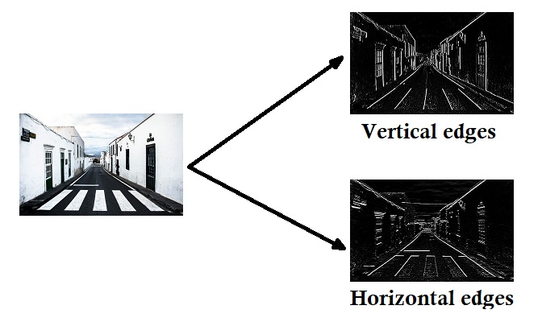
Edge Detection

Slide 13
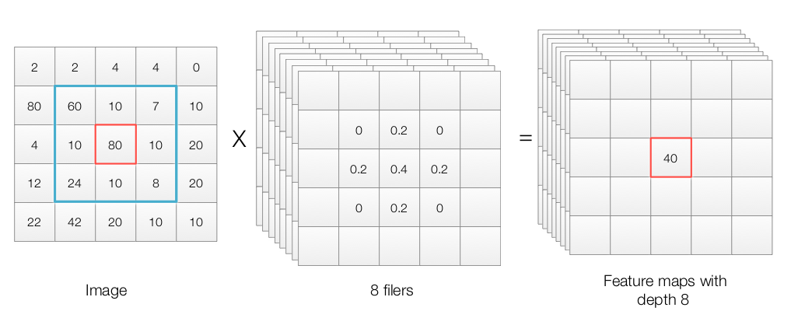
Depth
In CNNs, each layer consists of multiple filters (kernels), each producing a separate feature map. The number of filters in a layer determines its depth.

Slide 14
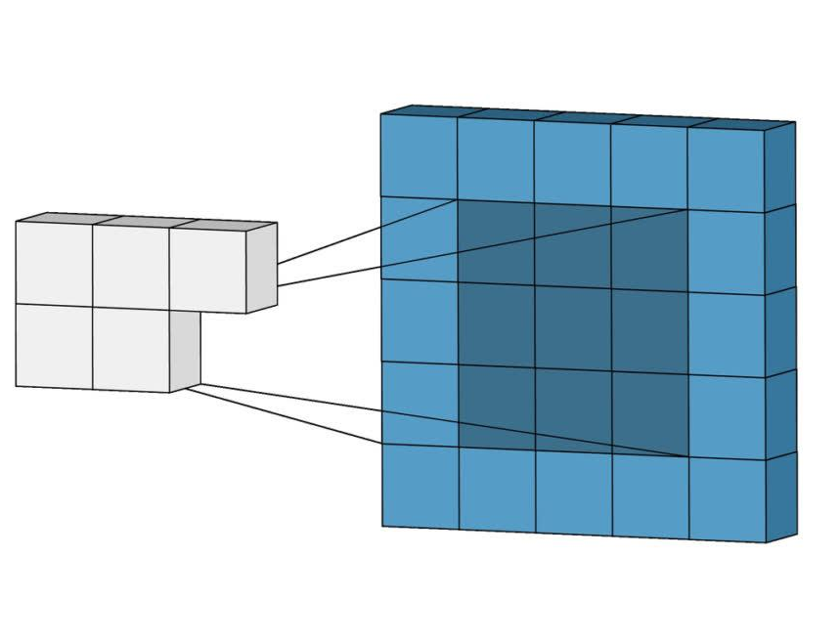
Padding
Padding is a technique used to maintain the
spatial dimensions of the input image after
performing convolution operations
on a feature map.
In plain English, a padding is “a
piece of material used to protect
something or give it shape.”

Slide 15
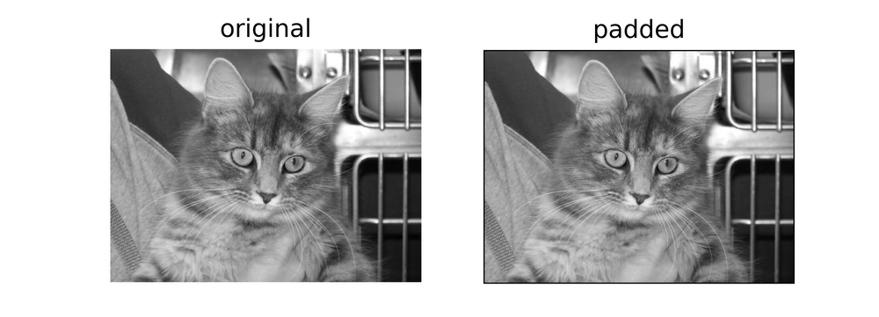
Padding

Slide 16
Types of Same Padding
Zero Padding
Ones Padding

Slide 17
Zero Padding

Slide 18
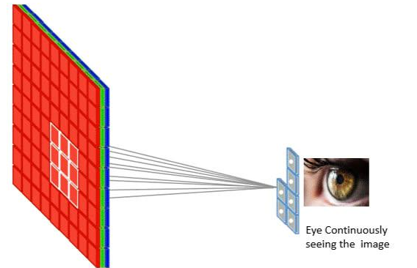
Pooling
Simplifying Complex Data:
Pooling is like summarizing information,
keeping what's important.
Dimensionality Reduction:
It helps reduce the dimensionality
while retaining essential information.
Pooling = Downsizing + Information Summary

Slide 19
Analogies to Understand Pooling
Image Compression Analogy
Pooling is like compressing an image file. You lose some details, but the essential features are still there.
Teacher Analogy
Imagine a teacher summarizing a chapter. They highlight the key points (max pooling) or give an overall summary (average pooling), making it easier for students to remember the main ideas.

